Slide 1

Team 2 Project
Teammate names removed for privacy

Slide 2
Introduction
Chosen hypothesis: Higher population density has an adverse effect on hypertension and diabetes of the population.
We will look into the following:
Looking into the top 10-15 biggest cities in Massachusetts and in Arizona, and comparing the cases of hypertension and diabetes
Why Arizona and Massachusetts? They of comparable populations of 7.28M and 6.99M respectively, but Arizona has nearly 11 times the number of square miles.
Then we will look into the proportions of people who do/do not have the conditions we chose, and compare those within the top 10-15 cities in each of the states, to see if the proportions of the conditions in big cities are similar to each other

Slide 3
Background Research
In a study published by Environ Health Prospect, 230 Latin American Cities that varied from large to small populations, were studied to see if hypertension was in fact more common in higher population dense cities. The study found that, “individuals with hypertension were also more likely to live in more populated cities, in cities with higher levels of fragmentation, in cities with a higher percentage of built-up area, and in cities with mass transit infrastructure (45.2% vs. 41.1%).”
The American Heart Association studied how noise pollution could affect hypertension in patients. Noise pollution is harmful sounds that occur in large and busy cities. Noise pollution is said to possibly increase stress. The AHA found in their study that, “Greater levels of noise were associated with higher blood pressure levels and greater risk of apparent treatment-resistant hypertension.”
A study done by Biomed Central found that, “Middle-aged and older adults who lived in densely populated neighbourhoods had higher odds of being overweight.”
Due to this factor Harvard University found that “85% of diabetics are overweight.”
The Framingham Heart Study found that, “78% of essential (primary) hypertension in men and 65% in women can be attributed to obesity.”

Slide 4
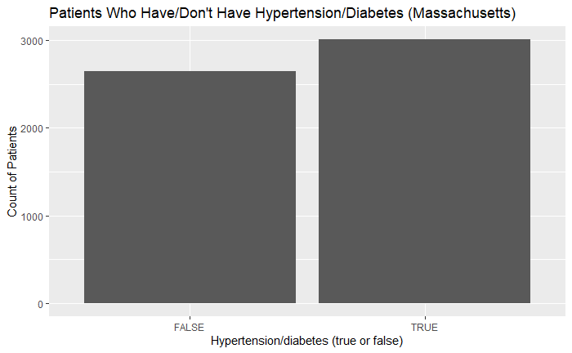
Problem Research: Proportion in Mass.
This graph shows the distribution of how many patients in Massachusetts do and do not have the conditions (hypertension/diabetes) in our total population sample. We can observe that approximately 3000 fell into the TRUE category and approximately 2600 fell into the FALSE category.

Slide 5
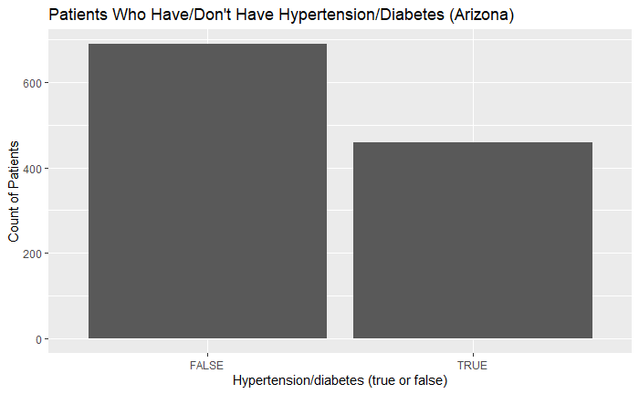
Proportions in Arizona
This graph shows the distribution of how many patients in Arizona do and do not have the conditions (hypertension/diabetes) in our total population sample. We can observe that approximately 475 fell into the TRUE category and approximately 700 fell into the FALSE category.

Slide 6
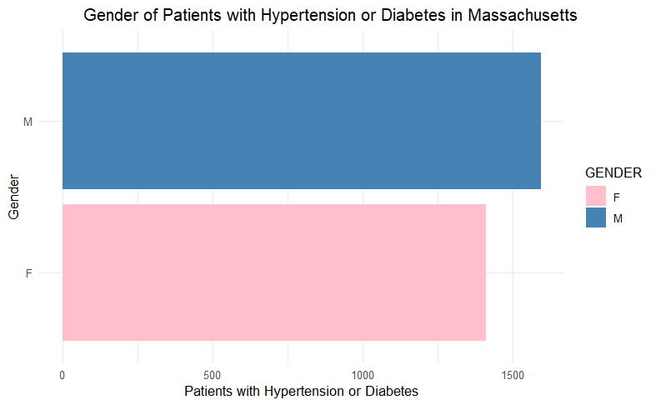
Massachusetts Gender Distribution
This graph shows the distribution of patients with either Hypertension or Diabetes in Massachusetts. It is separated between males and females. In total the population had 2834 Males and 2819 Females. Of these people 1595 Males and 1413 Females had either Hypertension of Diabetes. This shows us that 56% of males and 50% of females had either Hypertension or Diabetes, meaning that men were 6% more likely to be diagnosed with either of these conditions. Overall out of those who had hypertension or diabetes 53% were males and 47% were females, proving that men were more likely to have either of these conditions.
1,595 - 53%
1,413 - 47%

Slide 7
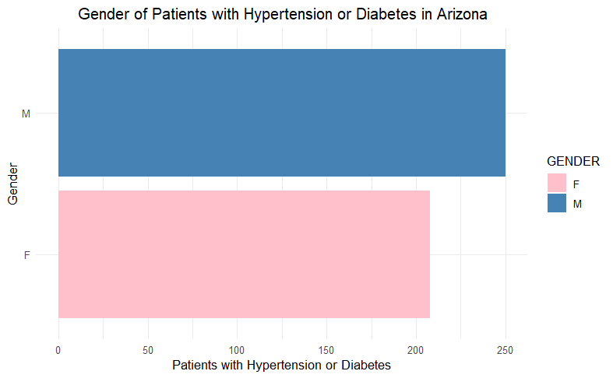
Arizona Gender Distribution
This graph shows the distribution of patients with either Hypertension or Diabetes in Arizona. It is separated between males and females. This population had less people than Massachusetts, so the total the population had 597 Males and 550 Females. Of these people 250 Males and 208 Females had either Hypertension of Diabetes. This shows us that 42% of males and 38% of females had either Hypertension or Diabetes, meaning that men were 4% more likely to be diagnosed with either of these conditions. We found it interesting how this population was much less likely to have these conditions. Overall out of those who had hypertension or diabetes 55% were males and 45% were females, again proving that men were more likely to have either of these conditions.
250 - 55%
208 - 45%

Slide 8
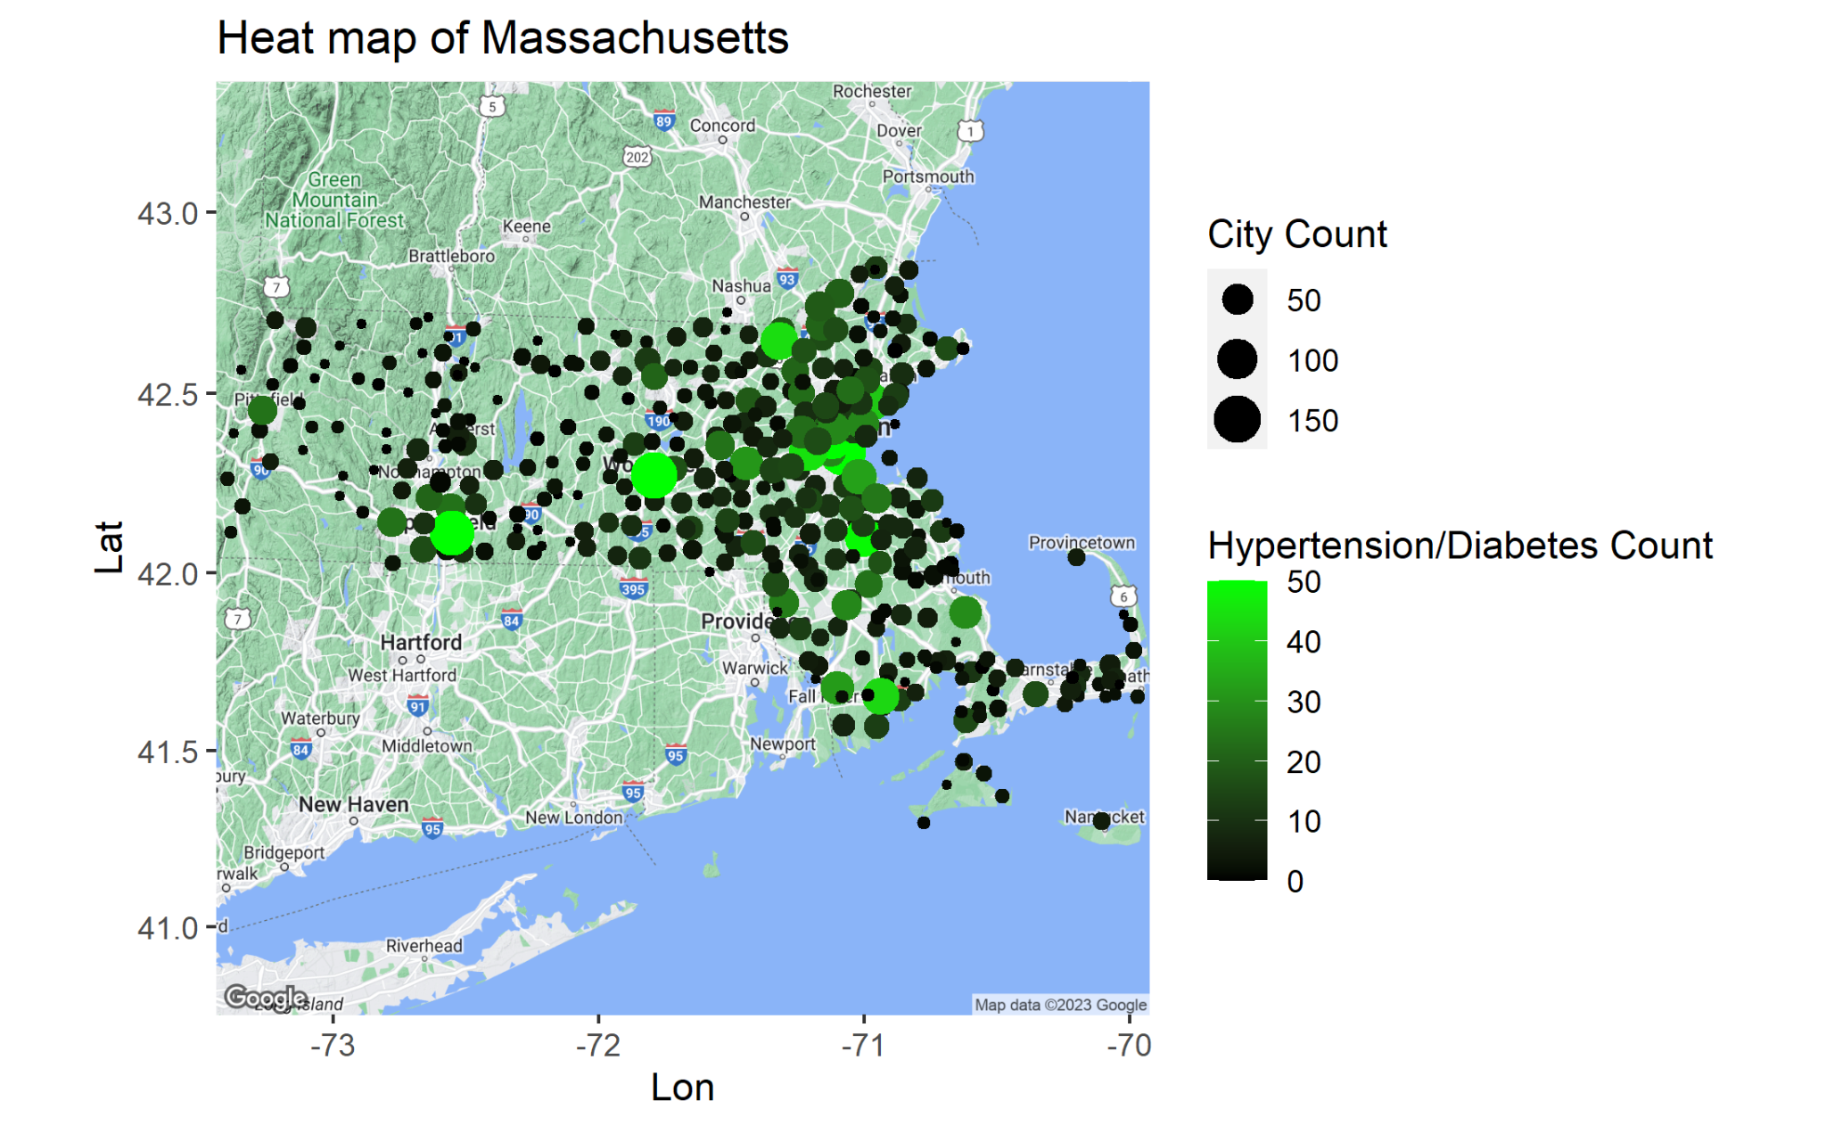
This visualization is a heat map of Massachusetts that shows the number of cases by color and number of persons for which we have data by size, all on an X-Y Axis of the longitude and latitude to how the different cities we have data in.

Slide 9
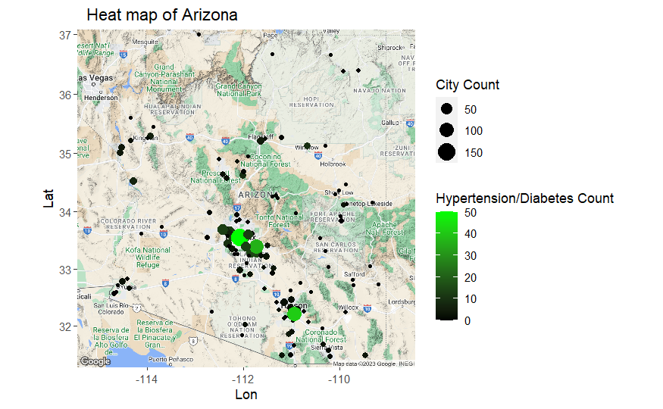
This visualization displays a heat map of the second population we analyzed. This shows how common hypertension or diabetes is in Arizona. It is clear that the two major cities have the highest count of hypertension or diabetes.
The city in the middle is Phoenix which has the largest population in Arizona with around 1.6 million people and the city under it with the second most cases is Tucson which is also the second largest city in Arizona with a population around 600,000.

Slide 10
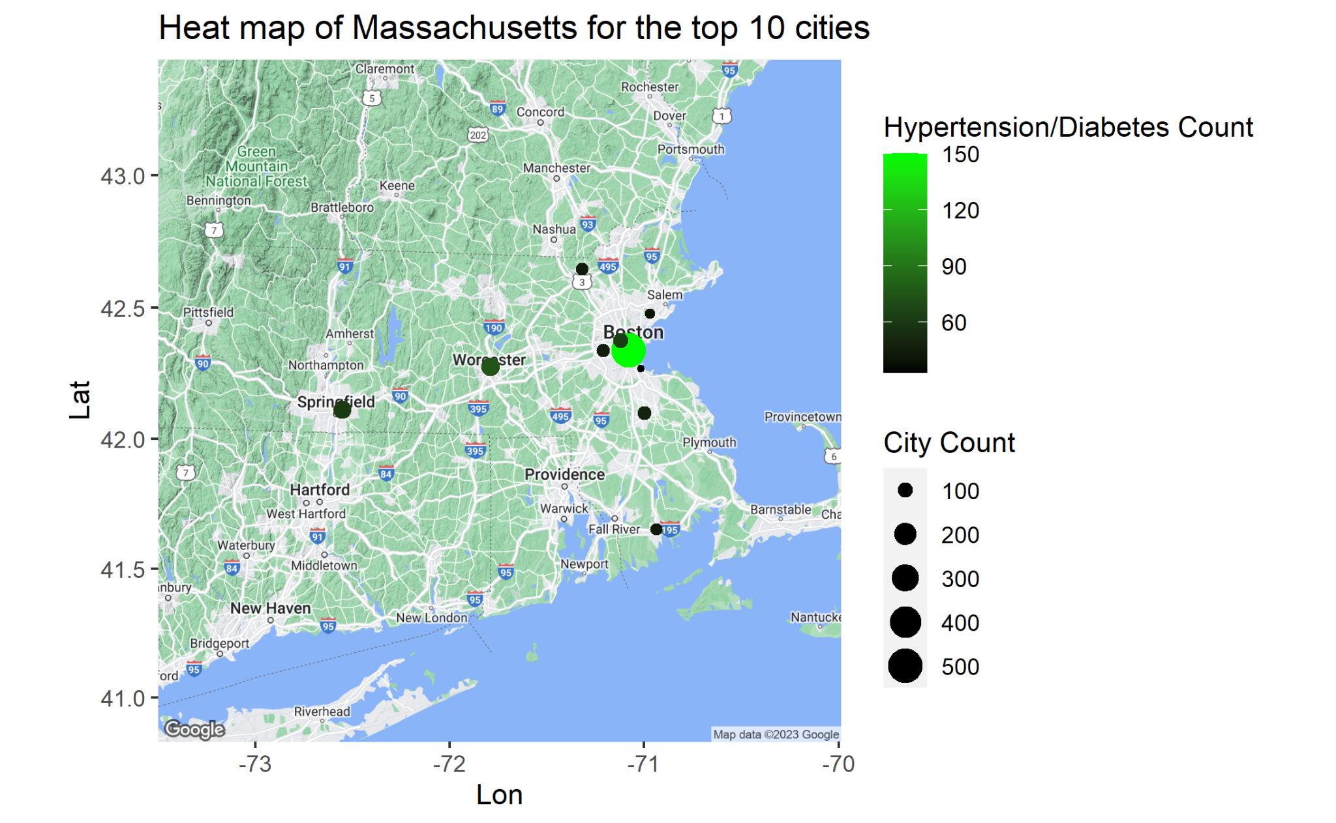
This visualization is a heat map of Massachusetts that shows the number of cases by color and number of persons for which we have data by size, all on an X-Y Axis of the longitude and latitude to how the different cities we have data in.
For this visualization, the data set was filtered down to the ten locations with the most data points. This was done to filter out the white noise, and allow the viewer to visualize whether or not the ration seems to be greater in metropolitan areas.
This line of thinking is what lead us to our next set of ratio tests.

Slide 11
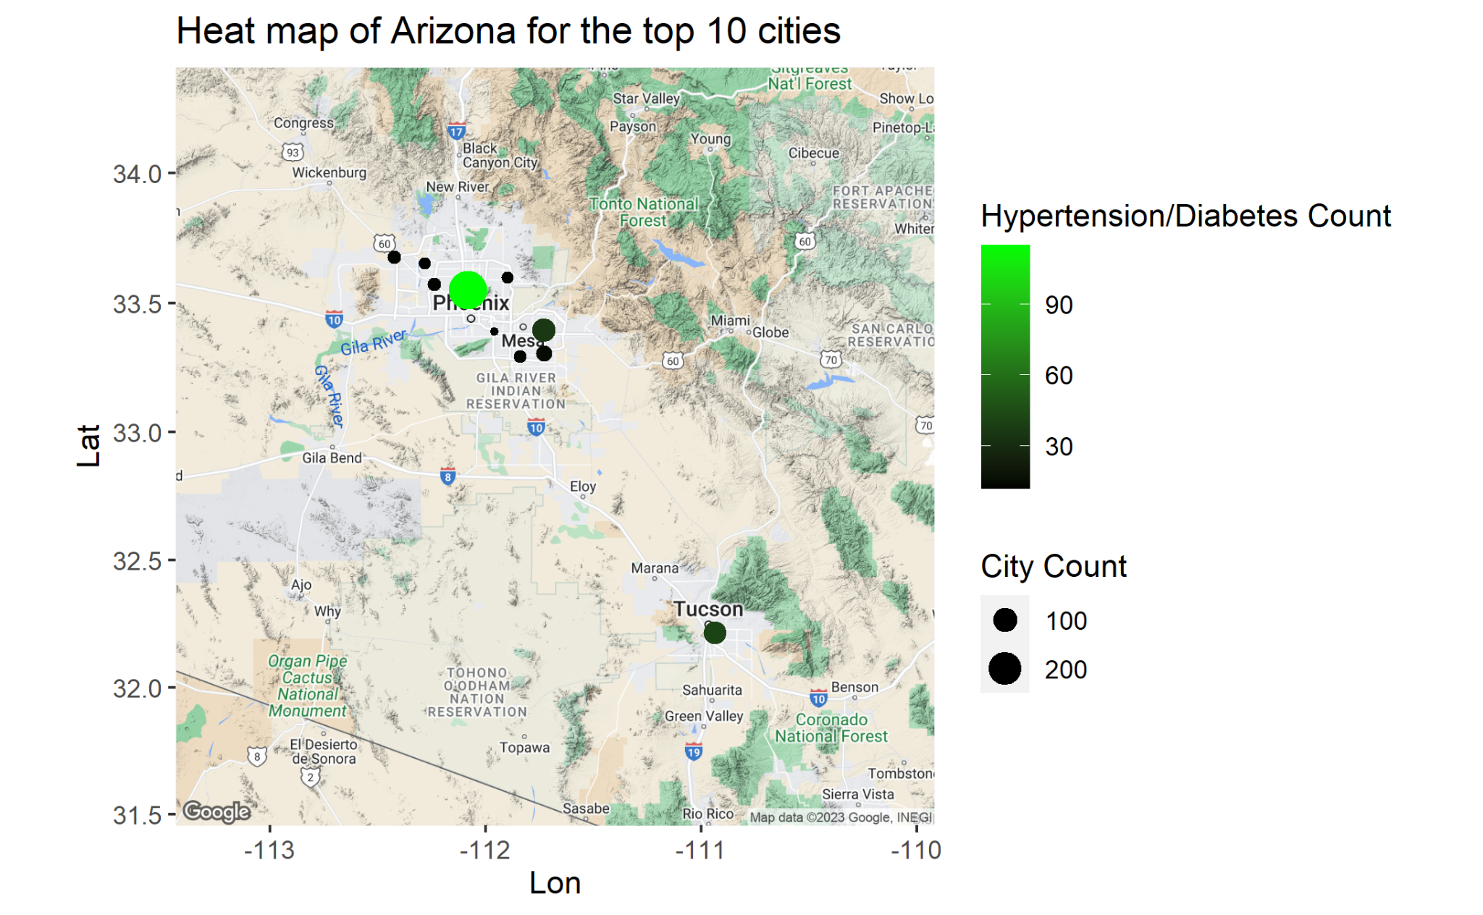
This visualization displays the top 10 cities that had the largest amount of people with hypertension or diabetes. The brighter the green the shows the total count of hypertension/diabetes. The larger the dot, shows the cities count of people in the data set created. This helped us to take a ratio of the population rather than comparing straight numbers against populations with differing densities. This shows how the larger cities typically had larger amount of hypertension/diabetes for the most part.

Slide 12
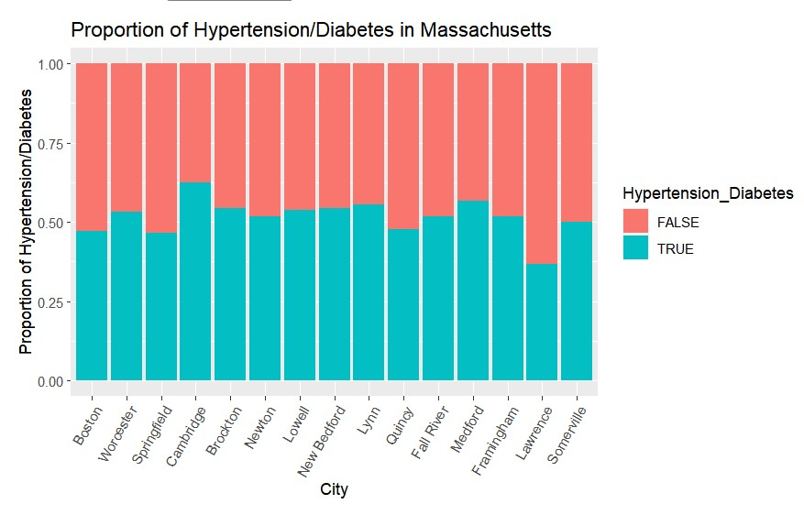
Proportion of Hypertension/Diabetes in Massachusetts
The graph on this slide has been sorted in decreasing order by city population from left to right, with Boston being the most populated city in Massachusetts. It shows the proportion of hypertension/diabetes in each city and tells us that there isn’t a significant trend as we move from most to less populated cities.

Slide 13
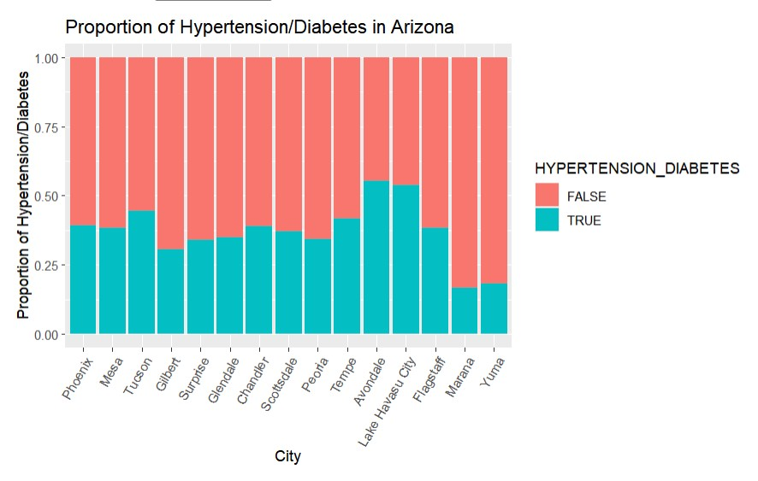
Proportion of Hypertension/Diabetes in Arizona
The graph on this slide shows the same data as the previous slide, except this one contains data for Arizona cities, still sorted from left to right by city population. Interestingly, Arizona, which is a less densely populated state, has a lower proportion of hypertension and diabetes than Massachusetts. However, the trends moving from city to city are unclear.

Slide 14
Hypothesis Testing
To test our hypothesis, we decided to make a variety of graphs including:
Histograms/bar graphs
Heat maps
Using the visualizations we made, and the background research that was performed, we were able to draw data-based conclusions. You will see the conclusions that we draw in the following slides.

Slide 15
Outcome
In the end, from what we’ve looked at, the safest course of action would be to reject our null hypothesis.
What we’ve seen is inconclusive at best and more lends itself towards saying that population density does not have an effect on the proportion of the population with diabetes/hypertension.
This is not a failure. We have not done a useless trial, but rather have opened our eye to a misconception we previously had.

Slide 16
Summary
We found that our hypothesis was not supported by our findings. There were more cases in the more dense population areas, however once we looked at the proportion of cases in each city (per state) and from the top 15 cities, there was no present pattern. We also discovered that in both states (Arizona and Massachusetts), men were more likely to fall into the “true” category for hypertension and/or diabetes.

Slide 17

Future Work
Explore population density by state and analyze effects
Look at hypertension and diabetes cases by age and gender
See if hypertension and diabetes correlates with any other conditions

Slide 18
Works Cited
https://www.ncbi.nlm.nih.gov/pmc/articles/PMC8846315/#:~:text=In%20addition%2C%20individuals%20with%20hypertension,41.1%25).
https://www.ahajournals.org/doi/10.1161/HYPERTENSIONAHA.121.17708#:~:text=We%20evaluated%2016%20462%20BP,of%20apparent%20treatment%2Dresistant%20hypertension.
https://professional.heart.org/en/science-news/weight-loss-strategies-for-prevention-and-treatment-of-hypertension/Commentary#:~:text=Findings%20from%20the%20Framingham%20Heart,can%20be%20attributed%20to%20obesity.
https://hqlo.biomedcentral.com/articles/10.1186/s12955-019-1172-3
https://news.harvard.edu/gazette/story/2012/03/the-big-setup/#:~:text=Studies%20have%20shown%20that%20becoming,percent%20of%20diabetics%20are%20overweight.
https://www.ncbi.nlm.nih.gov/pmc/articles/PMC5953551/
https://www.hopkinsmedicine.org/health/conditions-and-diseases/diabetes/diabetes-and-high-blood-pressure#:~:text=High%20blood%20pressure%20is%20twice,to%20heart%20disease%20and%20stroke.

